Slide 1
Database delivery
“…hmmmmm….“
Pregatit de Marcel Soare Data: 01.09.2016

Slide 2
Challenges / Problems
Continuous integration
Development
Deploy on production
Notes:
Deploy on production
Data
Schema
Versioning
Development problems
Merge conflicts on database objects (views and stored procedures)
Database should be on source control (schema and reference data – predefined lists)
Refactoring database structure
CI
Multiple environments
Test on database objects

Slide 3
What are we doing now
Shared database
Migrations
Scripts / State based
Notes:
Problems with shared database

Slide 4
Approach
State based
Migration based

Slide 5
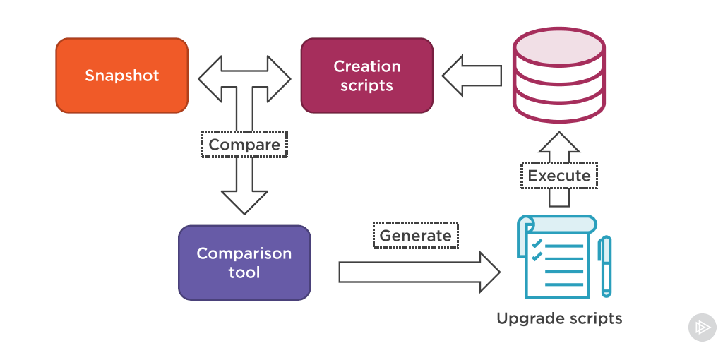
State based
service
files
logs

Slide 6
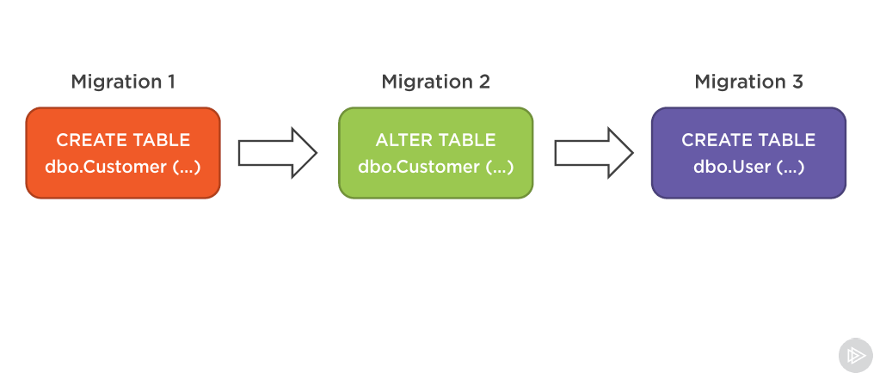
Migrations

Slide 7
Migrations Pro/Con
Up / Down (P)
Easy to deploy (P)
Merge conflicts on some database objects( C )
Notes:
What is a migration framework
Any modification to your database warrants a “Migration”. This migration has both an “Up” method (forward through time), and a “Down” method (backwards through time). With the use of commandline, nant, msbuild you can automate the migration process during deployments to different environments. The migration framework stores a table in each database (by default FluentMigrator calls it’s table “VersionInfo”, in which it stores what migrations have been applied to that database), with this information, the framework can determine what migrations need to be applied to that database (along with what version you told it to go to on the commandline) and will then execute each migration in succession that it needs to apply
Credits to Sean Chambers - https://lostechies.com/seanchambers/2011/04/02/fluentmigrator-getting-started/

Slide 8
Migration tools
EF migrations
Fluent Migrator
RoundHousE

Slide 9
Migration tools

Slide 10
Thank you!

